Slide 1
Perception & Bias
MGT 217
10/1/18

Slide 2
Are we logical?

Slide 3
Perception: Interpreting Our Environment
“Studies have shown that 90% of error in thinking is due to error in perception. If you can change your perception, you can change your emotion and this can lead to new ideas.”
    –Edward de Bono, author & psychologist
Notes:
In early 2007, the Washington Post carried out an experiment in perception by placing world-famous violinist Joshua Bell, disguised as a street musician, in a Washington Metro station. Wearing a baseball cap, t-shirt, and jeans, Bell performed a 43-minute set of six classical pieces for unsuspecting commuters. Of the 1,097 who passed by, only 7 stopped for just over a minute to listen to his virtuoso performance before continuing their journey. By the end of his performance, the virtuoso Bell had made a grand total of $30 and a few cents – hardly enough to buy a ticket to one of his own sell-out concerts. So what does this experiment tell us about perception? Was it because Bell was dressed as a street musician that the commuters did not stop to listen? Or was it because of the setting – after all, how likely is it that a world-famous musician decides to perform for free in a Metro station? Whatever the reason, we can conclude that most people perceived Bell to be someone other than who he was, which affected their ability to recognize him or the difficult music he was playing.

Slide 4
Perception
Perception: Interpreting Our Environment
The process by which we receive and interpret information from our environment
Notes:
We define perception as the process by which we receive and interpret information from our environment

Slide 5
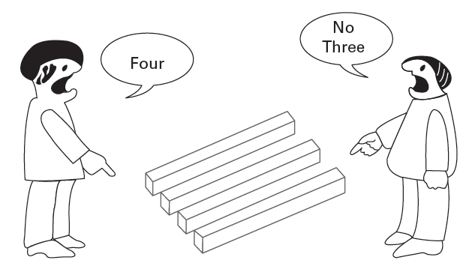
Components of the Selection Process
Figure 4.1: Optical Illusion
Factors that influence/distort perception:
Perceiver
Environment
Focal Object
Notes:
A number of factors influence and perhaps distort perception, including the perceiver, the environment, and the focal object. These will be discussed in depth in the following slides.

Slide 6
The Perceiver
Components of the Selection Process
Perceptions are shaped by
Past experiences
Culture
Attitude
Values
Upbringing
Notes:
Perceptions are shaped by past experiences, culture, attitude, values, upbringing, and more. This means the nature of the perceiver has a strong influence on the perceptual process. For example, say you were raised in an environment where working hard and being on time were considered very important. You might have a negative attitude towards a co-worker who comes to work late or takes long work breaks. Once you have formed this perception, it might be difficult for you to change your mind about your co-worker even if she or he performs well.

Slide 7
Why Is Perception Important?
Perceptions of Reality: In the workplace
In the workplace, the way we are perceived and the way in which we perceive others are crucial for career progress, and for building our relationships.
Notes:
In 1936, psychologist, Kurt Lewin observed that people act not upon the basis of reality, but upon their perceptions of reality. In other words, we tend to interpret events differently from what actually happens in our environment. Therefore, understanding perception is a critical part of understanding behavior. In the workplace, the way we are perceived and the way in which we perceive others are crucial for career progress, and for building our relationships. For example, a salesperson’s success or failure depends on how he is perceived by prospective customers. He could have all the knowledge in the world about a product, but if he is perceived as over-eager or too talkative, he is unlikely to make the sale. This is why many people in a sales role use self-critiquing techniques such as videoing themselves or seeking feedback from others in order to perceive themselves as others do. Salespeople who actively listen, communicate sincerely, and show a genuine interest in the person to whom they are selling tend to excel and to have more successful customer relationships.

Slide 8
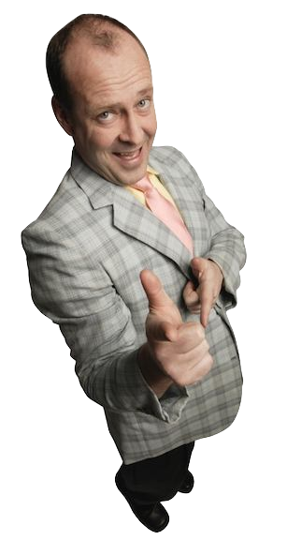
Stereotyping
Assigning traits to people based on social category membership
Occurs because:
  Categorical thinking
  Innate drive to understand and anticipate others’ behavior
  Enhances our self-concept

Slide 9
Perceptual Effects
Stereotypes
  Individual’s fixed beliefs about the characteristics of a particular group. When we have a particular feeling or attitude (often negative) towards members of a specific group, we call this prejudice.
Selective attention
  Tendency to selectively focus on aspects of situations that are most aligned with our own interests, values, and attitudes.
Primacy Effect
  Perception problem in which an individual assesses a person quickly on the basis of the first information

Slide 10
Additional Biases and Errors
Decision Making in Reality
Common-information bias
Confirmation bias
Hindsight bias
Escalation of commitment
Sunk cost bias
Notes:
Our decision making is often influenced by different types of bias. Recognizing and minimizing these biases is crucial for making accurate decisions.
Common-information bias is the inclination to overemphasize information held by the majority of group members while failing to consider other perspectives held by the minority. For example, in a voting situation, people often go along with the common or majority view rather than take the time to learn about and discuss other views. Confirmation bias is the tendency to seek out information that fuels or confirms our pre-existing views and to discount information that conflicts with them. For example, say you want to move to a country in Europe for a couple of years. During your research, you only look at the aspects that support your own beliefs about that country (historic, scenic, cultural, etc.) and overlook information that presents alternate viewpoints (unpredictable weather conditions, cultural differences, cost of living, etc.). Ease of recall bias is the propensity to over-rely on information recollected from memory when making a decision. For example, an investor might provide inaccurate information about a stock by plucking figures from his memory instead of taking the time to locate the exact information.
Sunk cost bias is the decision to continue an unwise investment based on past investments of time, effort, and/or money. For example, you might be reluctant to sell your car for a reasonable price because you spent so much to fix it (your sunk cost) and you think it is worth more than it is. Framing error is the tendency to highlight certain aspects of a situation, either positive or negative, to solve a problem while ignoring other aspects. For example, suppose the company president tells her executive team that the company, which employs 2,000 workers, has an annual turnover of 2%. A positive frame views this percentage as low, requiring very little action, whereas a negative frame perceives the loss of 40 employees a year as unacceptable and is likely to spark discussions about how to resolve this perceived problem.

Slide 11
Confirmation bias
  Inflate quality of the selected option; forget or downplay rejected alternatives
  Caused by need to maintain a positive self-concept
Escalation of commitment
  Repeating or further investing in an apparently bad decision
  Caused by self-justification, self-enhancement effect, prospect theory effect, closing costs

Slide 12
Perceptual Effects
Halo effect
  One trait affects perception of person’s other traits
False-consensus effect
  Overestimate how many others have similar beliefs or traits like ours
Recency effect
  Most recent information dominates perceptions
Anchoring effect
  Relying too heavily on the first piece of information

Slide 13
Videos Examples
Confirmation bias: https://www.youtube.com/watch?v=yxDDrEA497E
Anchoring: https://www.youtube.com/watch?v=eqTLPtPMKLs
Overconfidence: https://www.youtube.com/watch?v=wYNt72A7Lys

Slide 14
Common Attribution Errors
Attribution theory holds that people look for two causes to explain the behavior of others.
internal attributions
external attributions
Notes:
When we see someone behave in a certain way, we tend to try and make sense of it or at least attach some meaning to it. Attribution theory holds that people look for two causes to explain the behavior of others: internal attributions, which are personal characteristics of others, and external attributions, which are situational factors.

Slide 15
Attribution Process
Internal Attribution
External Attribution
Perception that behavior is caused by person’s own motivation or ability
Perception that behavior is caused by factors beyond person’s control (situation, fate, etc.)

Slide 16
Attribution Rules
Internal Attribution
Frequently
Consistency
Seldom
Frequently
Distinctiveness
Seldom
Seldom
Consensus
Frequently
External Attribution

Slide 17
The Case of the Late Student…

Slide 18
Attribution Errors
Fundamental Attribution Error
  attributing own actions to internal and external factors and others’ actions to internal factors
Self-Serving Bias
  attributing our successes to internal factors and our failures to external factors

Slide 19
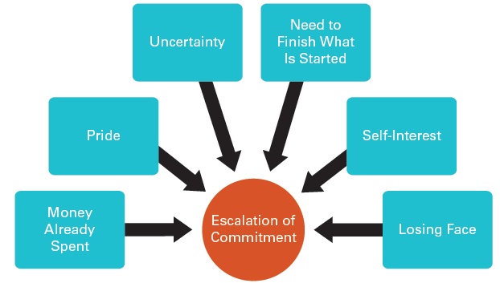
Biases and Errors
Decision Making in Reality
Figure 8.4: Escalation of Commitment Effect
Notes:
Escalation of commitment is the increased commitment we may make to a decision despite receiving negative information about the consequences. For example, a manager may choose to invest in more and more training for an underperforming employee even though the evidence suggests the likelihood of the employee’s improving is negligible.

Slide 20
Strategies to Improve Perceptions
Awareness of perceptual biases
Improving self-awareness
Meaningful interaction
  Close, frequent interaction toward a shared goal
  Equal status
  Engaged in a meaningful task

Slide 21
Next Week
Chapter reading & supplementary reading on Blackboard

